Slide 1
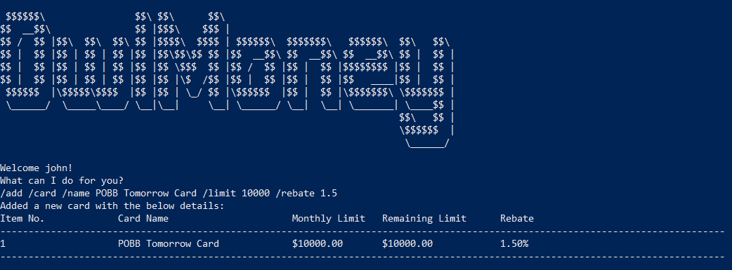
Command entered
Successful addition of card

Slide 2
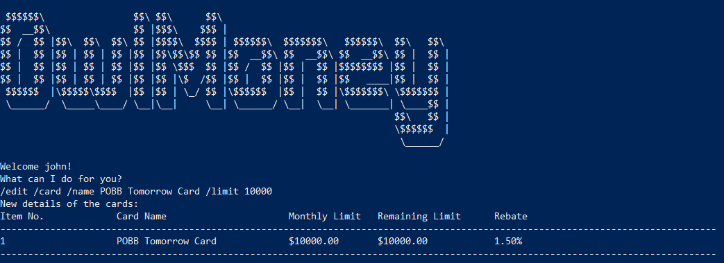
Command entered
Successful edition of card limit

Slide 3
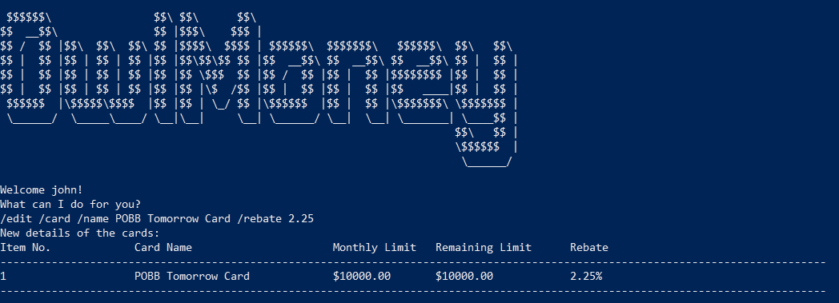
Command entered
Successful edition of card rebate

Slide 4
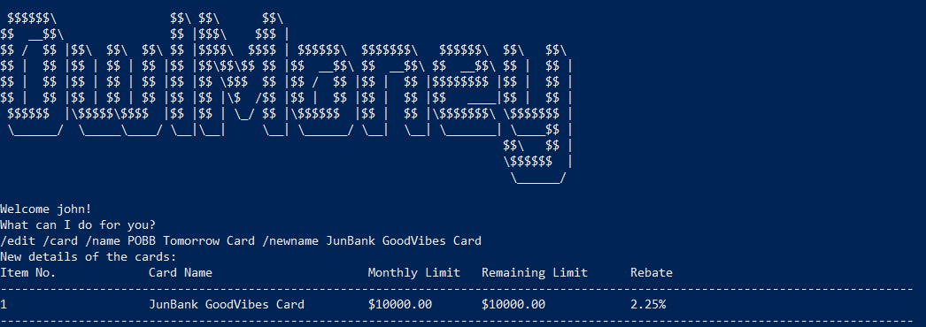
Command entered
Successful edition of card name

Slide 5
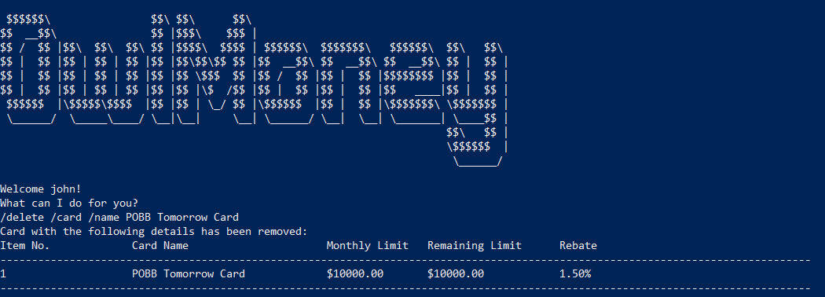
Command entered
Successful deletion of card

